Slide 1


Wildfire Risk Prediction – Utah Focus
Midterm Capstone Progress
Jared Nusink
February 2026

Slide 2
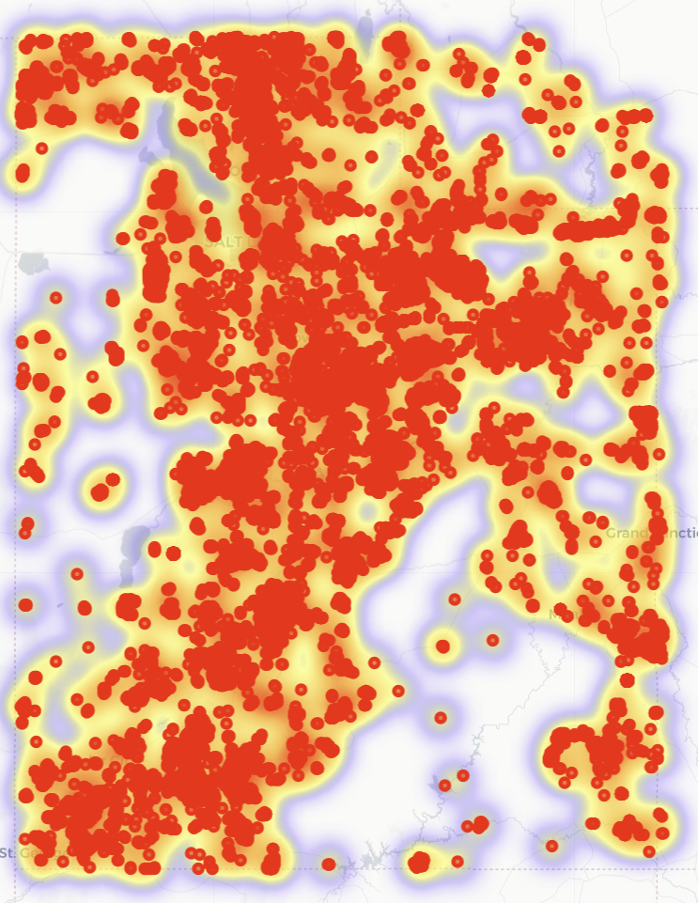
Problem & Research Question
Wildfires in Utah are increasing due to climate change, drought, and human activity
Key challenge: Most national models overlook local factors like dust from the shrinking Great Salt Lake, which dries fuels and increases ignition risk
Research question: How can incorporating Great Salt Lake dust exposure and human proximity improve wildfire ignition prediction in Utah?
Scope: Focus on Wasatch Front and Saratoga Springs areas
Explanation of need: Better local predictions can save lives, property, and resources (e.g., 2020 Utah fires cost $150M)

Slide 3
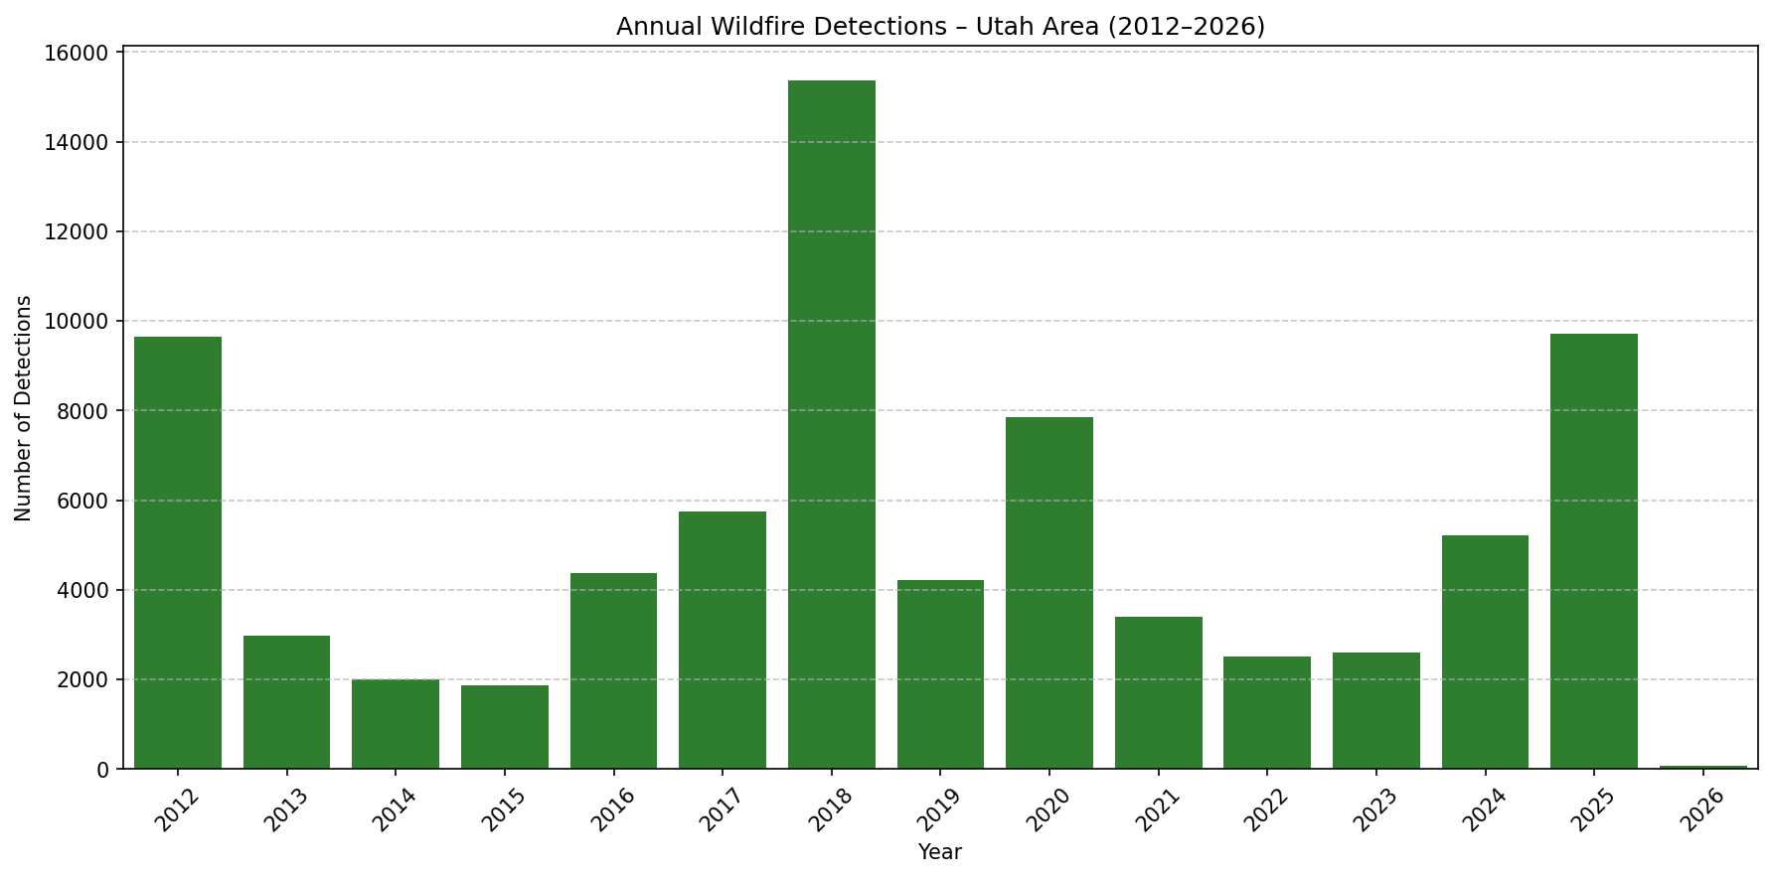
Novelty & Real-world Impact
Novelty: First model to include Great Salt Lake dust exposure as a feature (inverse distance score)
Adds human ignition proxy: distance to roads and cities (major cause of Utah fires)
Hybrid ML + physics: XGBoost classifier + dryness adjustment for interpretability
Real-world impact: Localized risk forecasts for Wasatch Front (e.g., Saratoga Springs) can guide prevention, evacuation, and resource allocation
Potential: Integrate with Utah DEQ air quality or UFS fire apps for public use

Slide 4
Dataset & Metadata
Source: NASA FIRMS (VIIRS satellite) active fire detections, 2012–2026
Size: ~3 million records → filtered to Utah subset (77,566 high-confidence fires)
Key metadata: latitude/longitude (location), acq_date (time), brightness/frp (intensity proxy), confidence (quality filter)
Labeling: Binary ignition (1 if fire detected in grid cell that day, 0 otherwise)
Augmentation: Dust exposure, road distance, dryness proxies from weather metadata
Stored in DuckDB for efficient querying (local file)

Slide 5
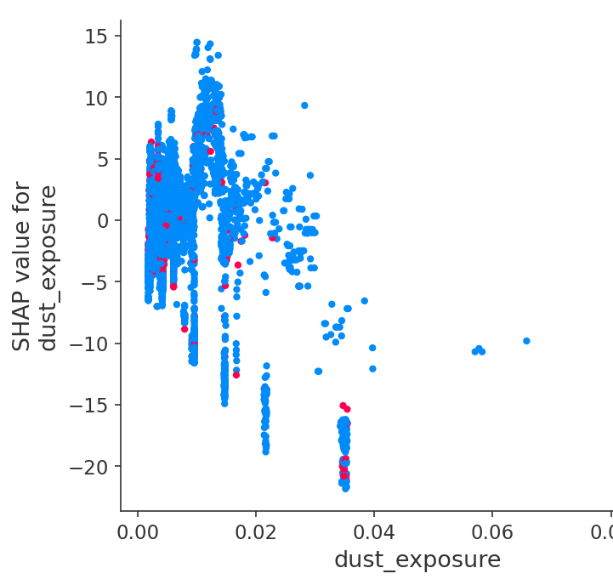
Data Cleaning & Feature Engineering
Cleaning: Removed low-confidence detections, clipped to Utah bounds (lat 37–42, lon -114 to -109)
Processing: Grouped to 0.1° grid cells, created daily labels (13.57M rows)
Feature engineering:
Dust exposure (inverse distance to lake center)
Road proximity (cdist to highway points)
Dryness proxies (VPD from temp/RH, diurnal temp range, low-precip boost)
Month, lat/lon
Handled imbalance (scale_pos_weight = 3301)

Slide 6
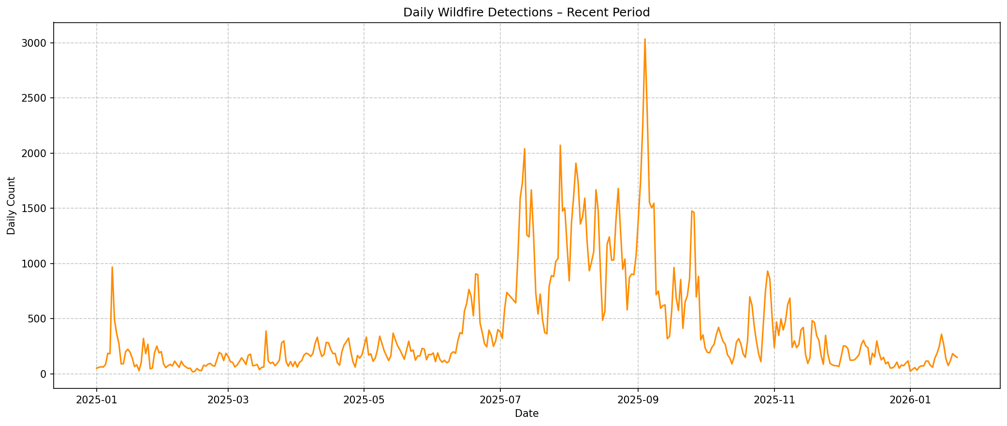
Data Analysis
Fire trends: Peaks in July–August, increasing over time (EDA graphs in plots/)
Imbalance: 0.03% fire days (99.97% no-fire) — typical for rare events
Dust exposure: Max 1.0 near lake, mean 0.00004
Road proximity: Lower distances near urban corridors like Wasatch Front

Slide 7
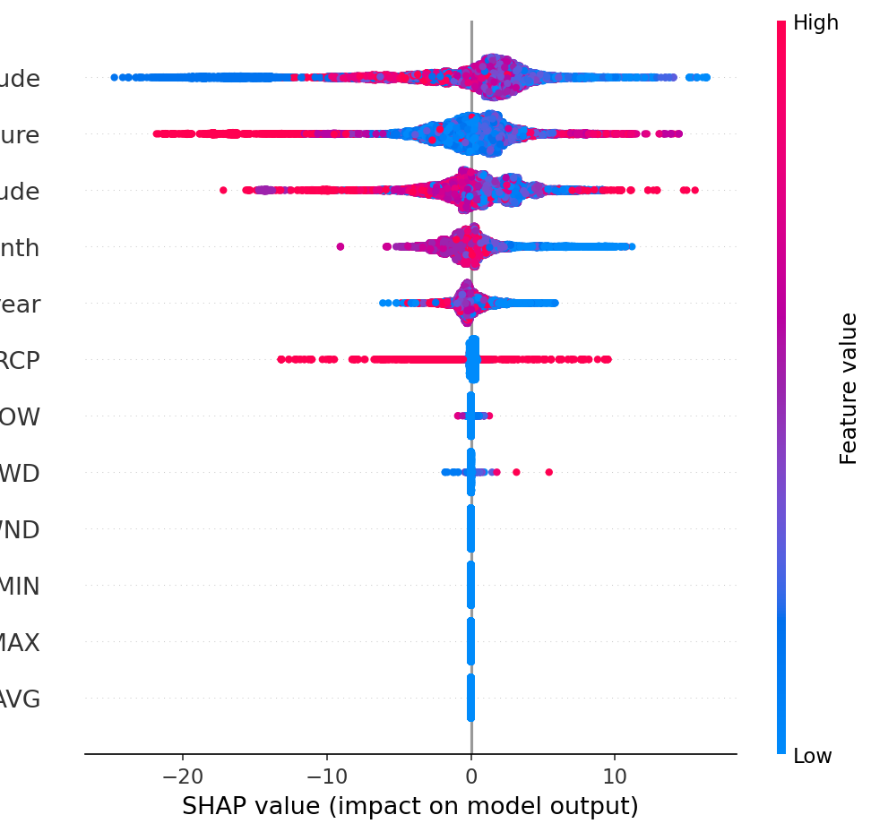
Data Visualization
Yearly fire trends: Increasing detections, peaks in 2018 & 2025
Monthly seasonality: July/August hotspot
Dust exposure map: Higher near lake
Daily risk forecast: Interactive heatmap (screenshots in plots/)
SHAP plots: Feature importance & interactions (e.g., dust + dryness)

Slide 8
Modeling Approach & Execution
Task: Binary classification (ignition 0/1 per grid cell-day)
Model: XGBoost Classifier with imbalance handling (scale_pos_weight = 3301)
Execution: Trained on 13.57M rows (10M subset for midterm)
Validation: Test set (20%), AUC-ROC metric
Hybrid: Physics boost for dryness/wind/dust

Slide 9
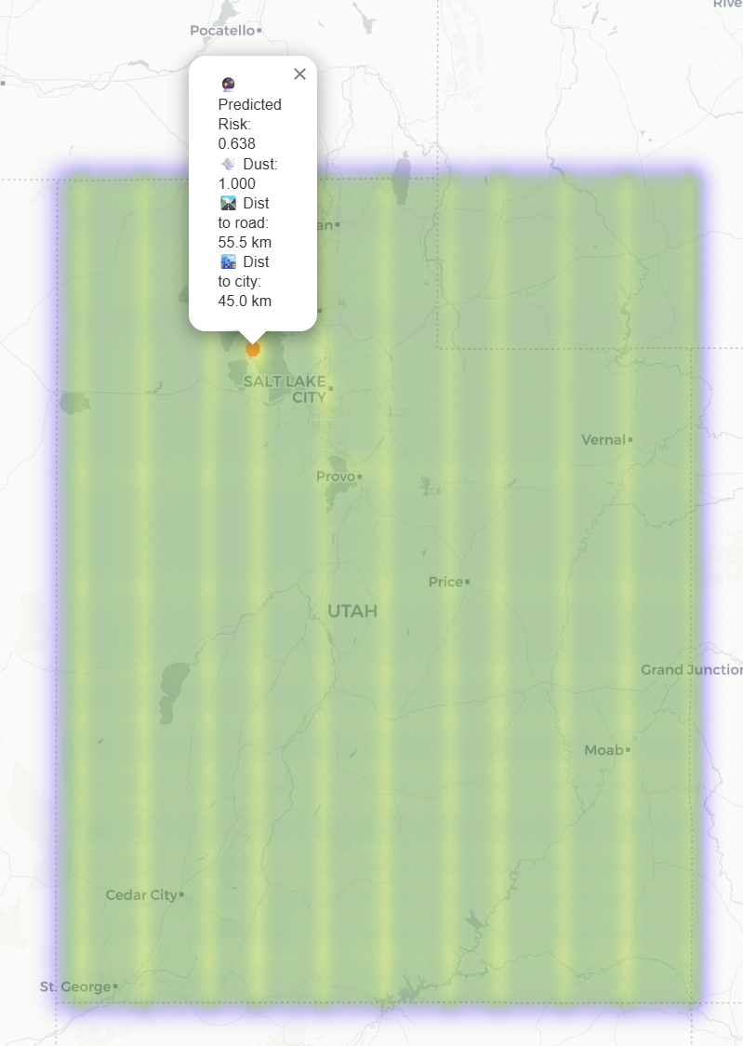
Results & Interpretation
AUC-ROC: 0.9671 (strong for rare events)
Recall for fires: 0.91 (catches 91% of actual fires)
Interpretation: Model prioritizes safety (high recall, some false positives)
Impact: Better risk forecasts for Utah (e.g., lake dust hotspots)

Slide 10
Conclusion & Next Steps
Conclusion: Novel dust model improves Utah risk prediction
Next: Full grid training, per-cell weather, Streamlit dashboard

Slide 11

Thank You!

